Slide 1
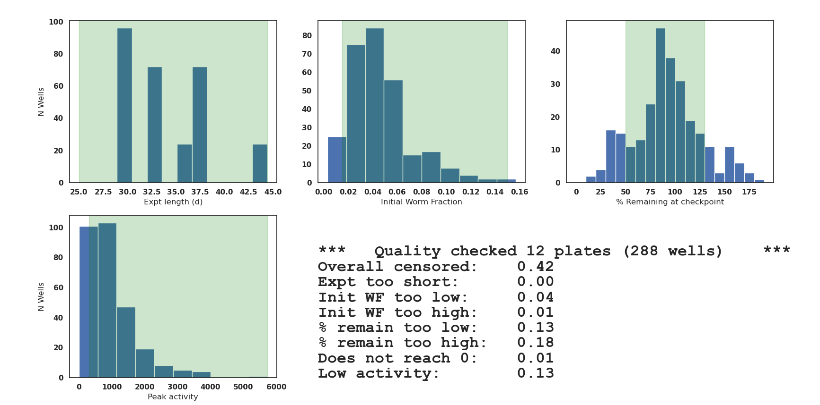
Autofilter results and explanation for WI 12 plates
Not enough worms to start
Too many worms to start
Worms escaped
If many more worms at day 10 vs day 3, could be FUDR failure (progeny) or worms too young/old when prepared
Should not be motion at day 30+, unless expecting extremely long lived mutant.
Not enough worms at start or worms not healthy / moving

Slide 2
Analysis done with autofilters
(consistent with RNAi screen methods)
+ last 4 plates added (Plates 8x), 12 plates total

Slide 3
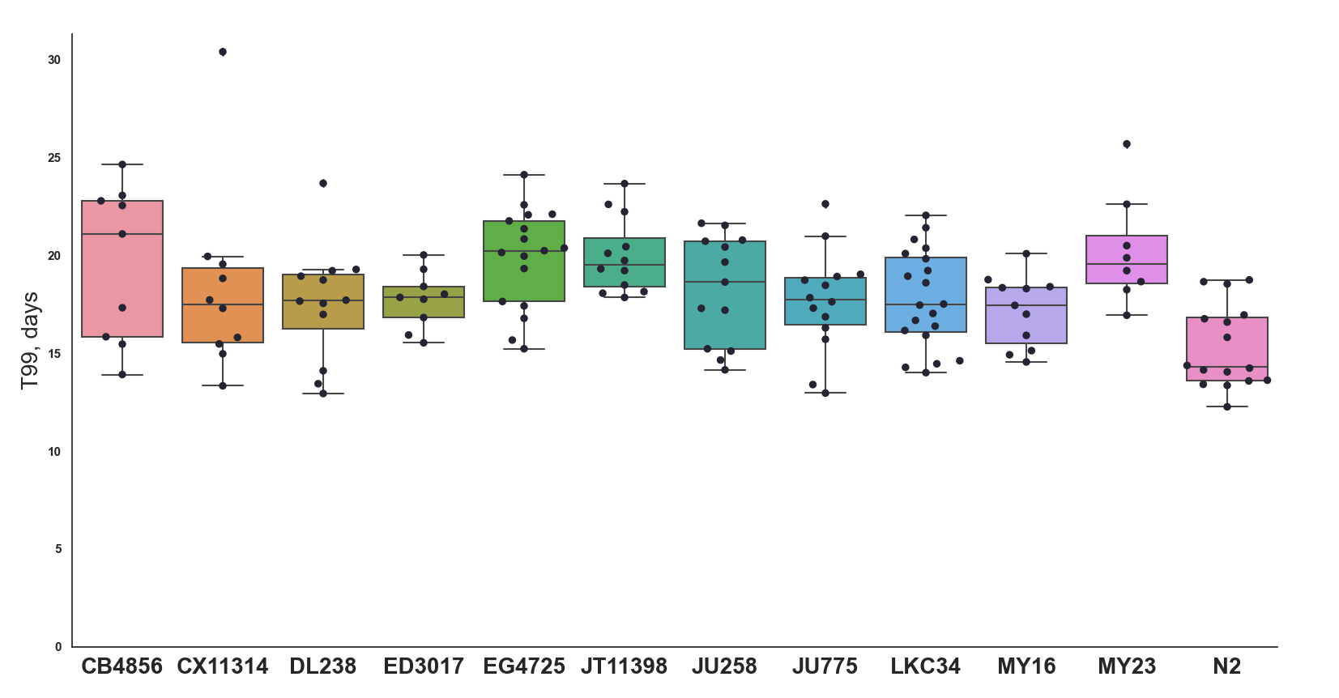

Slide 4
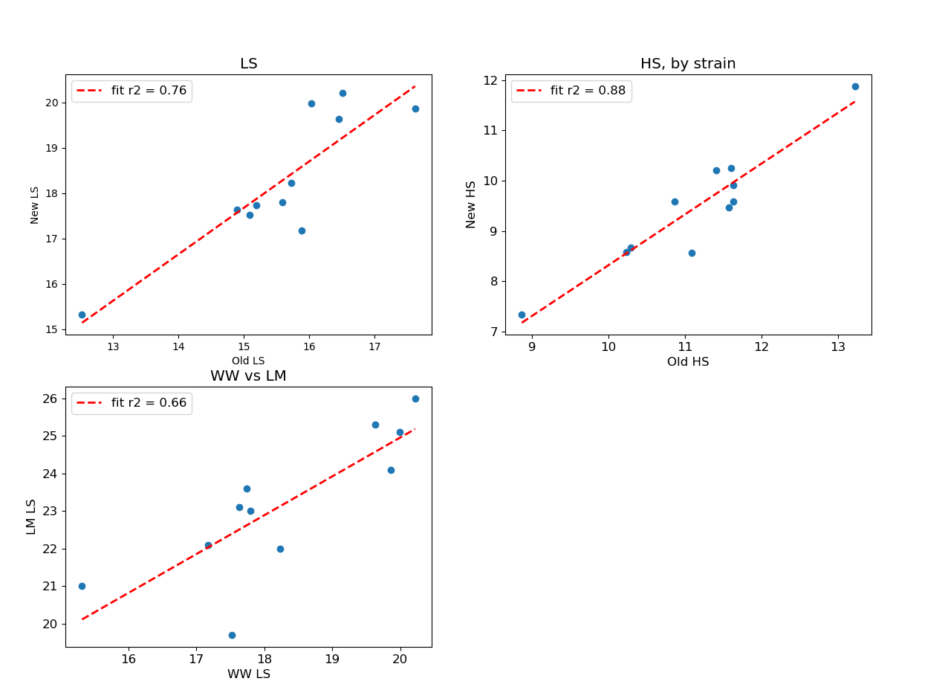
Analysis done with autofilters (consistent with RNAi screen methods)
Correlations between WW 2019 and WW2021 results, AND WW2021 vs LM
DL238 new outlier

Slide 5
Analysis done without autofilters
+ last 4 plates added (Plates 8x), 12 plates total

Slide 6
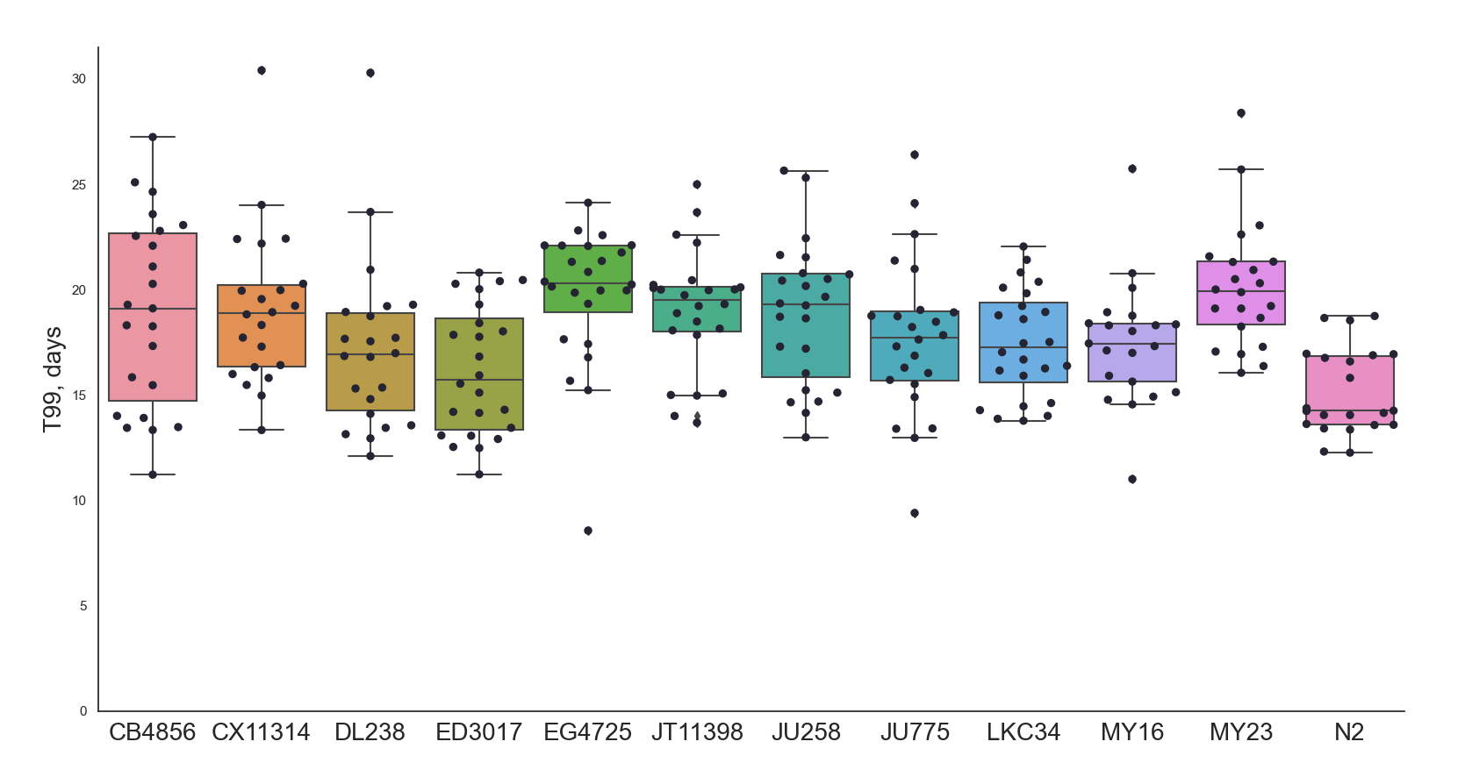

Slide 7
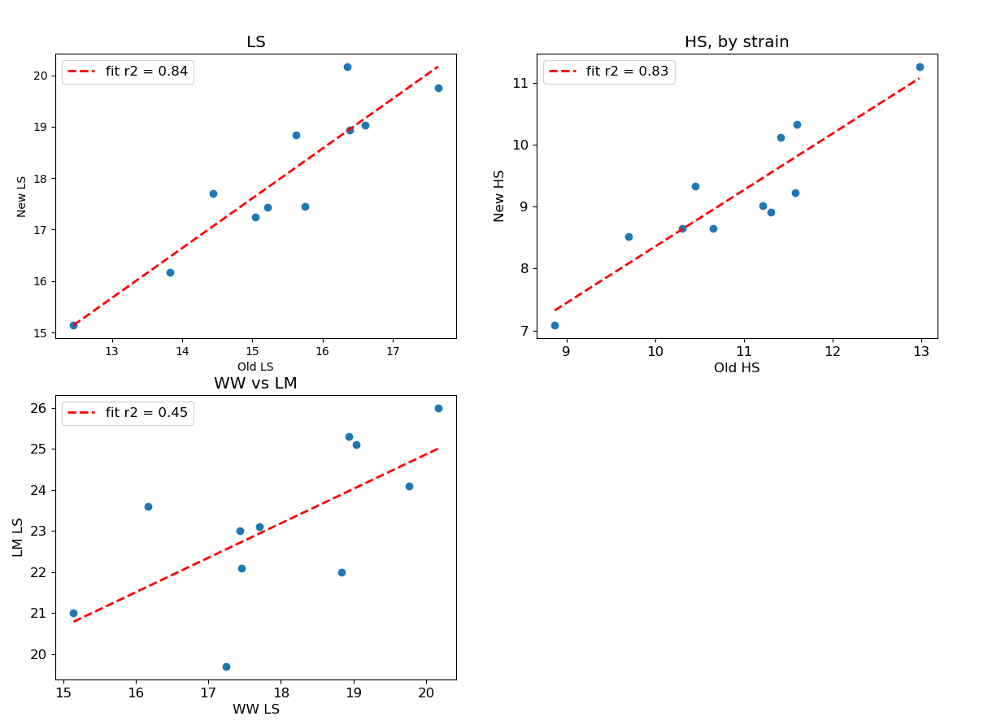
Analysis done without autofilters (consistent with RNAi screen methods)
Correlations between WW 2019 and WW2021 results, AND WW2021 vs LM

